Slide 2

Natural Language Processing
Transformers as Language Models
Mamatha.H.R
Department of Computer Science and Engineering

Slide 3

NATURAL LANGUAGE PROCESSING
Disclaimer
These slides are largely prepared from
https://www.entrypointai.com/blog/pre-training-vs-fine-tuning-vs-in-context-learning-of-large-language-models/
https://medium.com/nerd-for-tech/gpt3-and-chat-gpt-detailed-architecture-study-deep-nlp-horse-db3af9de8a5d

Slide 4
NATURAL LANGUAGE PROCESSING
Transformer as Language Models
Language modeling is the task of assigning probability to sentences in a language. The goal for language modeling is for the model to assign high probability to real sentences in our dataset so that it will be able to generate fluent sentences that are close to human-level using the transformer architecture.

Slide 5
NATURAL LANGUAGE PROCESSING
Large Language Models
A large language model (LLM) is a statistical language model, trained on a massive amount of data, that can be used to generate and translate text and other content, and perform other natural language processing (NLP) tasks.

Slide 6
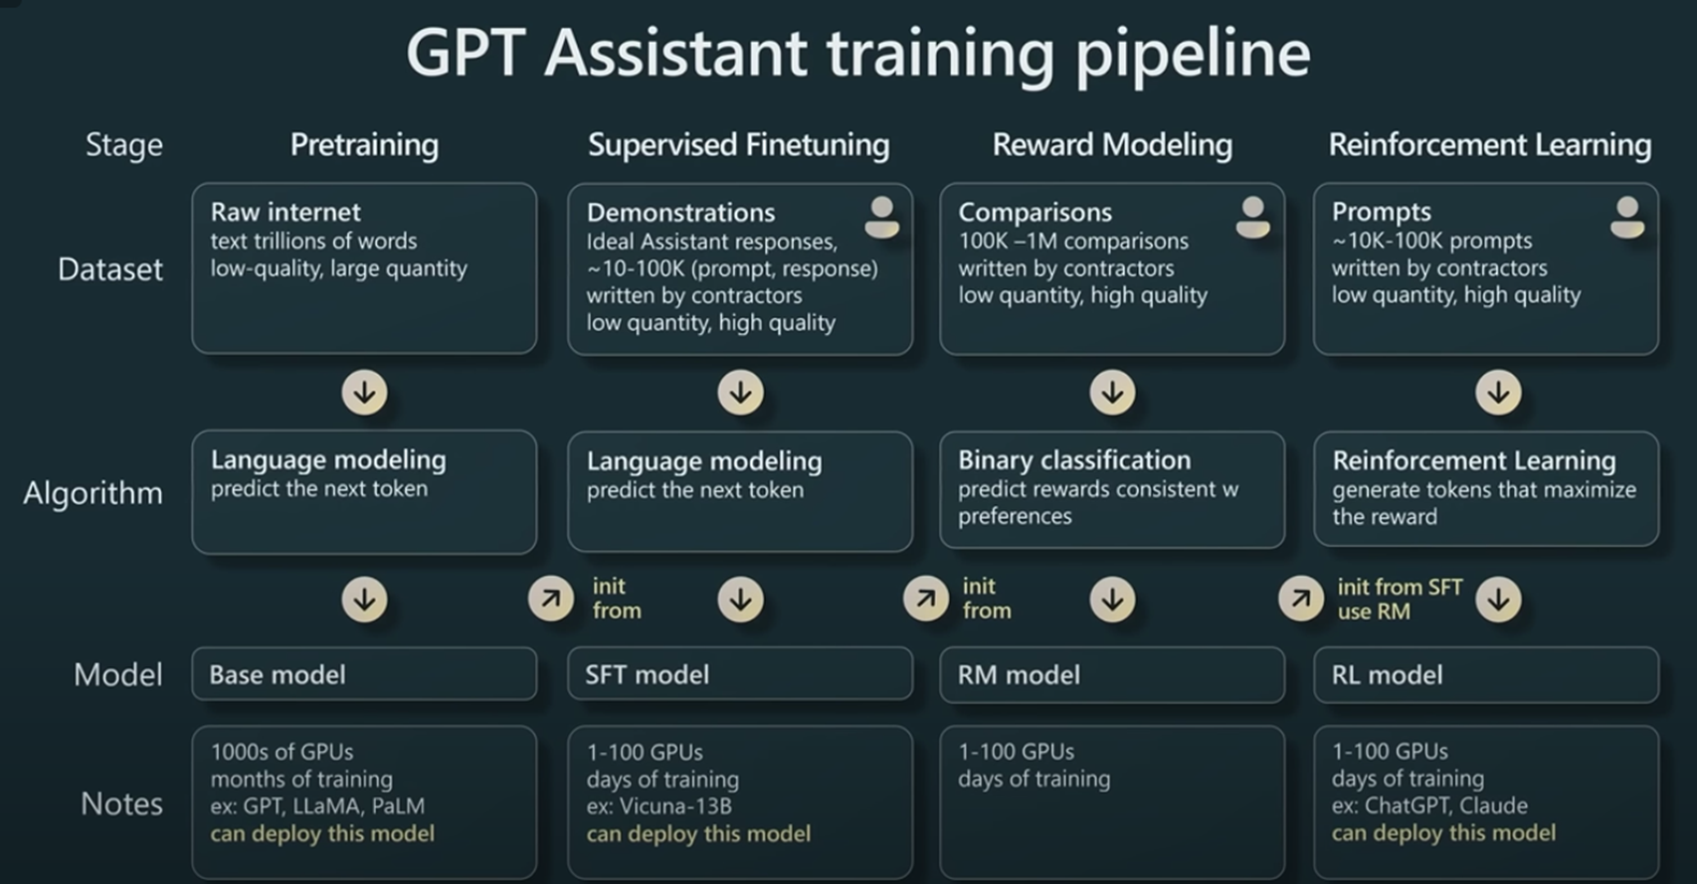
NATURAL LANGUAGE PROCESSING
LLM Training Pipeline
Source: Andrej Karpathy’s Keynote at Microsoft Build 2023

Slide 7
NATURAL LANGUAGE PROCESSING
LLM Training Pipeline - Pre-training
Pre-training in unsupervised learning is like immersing the model in a vast sea of text data without any right or wrong answers for guidance. The main goal is next-token prediction on a specific architecture of transformers.

Slide 8
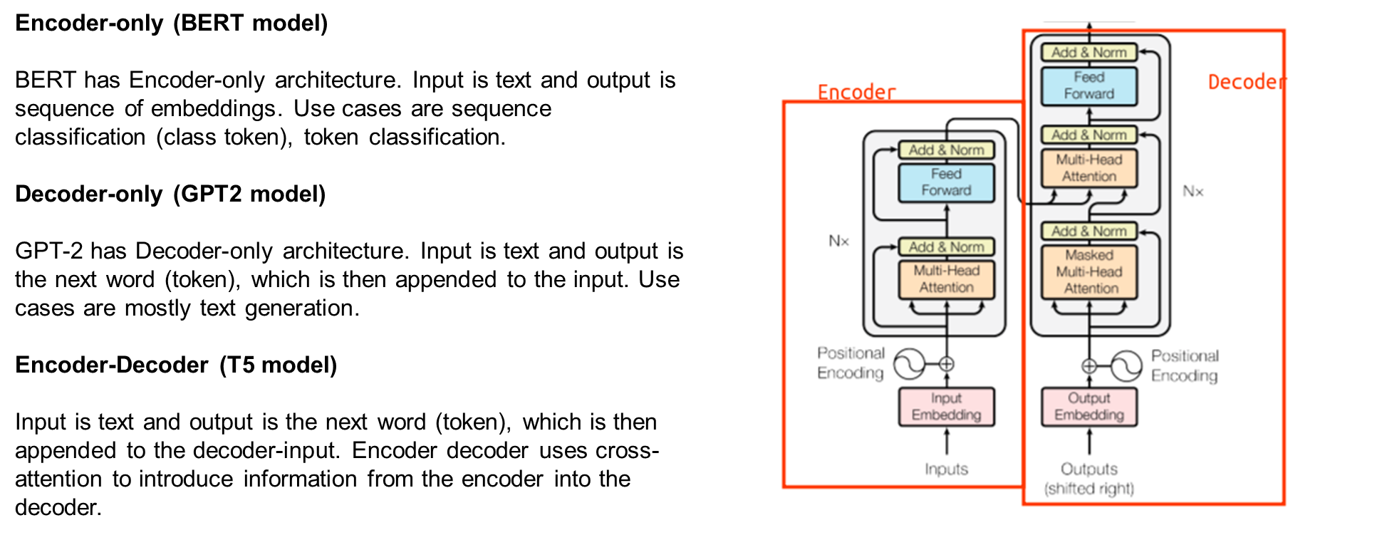
NATURAL LANGUAGE PROCESSING
LLM Training Pipeline - Pre-training

Slide 9
NATURAL LANGUAGE PROCESSING
LLM Training Pipeline - Supervised Fine-tuning
How can we train a specialized LLM over our own data? Recent advances in generative AI are powered by massive models with many parameters, and training such an LLM requires expensive hardware (i.e., many expensive GPUs with a lot of memory). Luckily, these models are usually trained in two phases—pretraining and finetuning—where the former phase is (much) more expensive. Given that high-quality pretrained LLMs are readily available online, most AI practitioners can simply download a pretrained model and focus upon adapting this model (via finetuning) to their desired task.
Nonetheless, the size of the model does not change during finetuning! As a result, finetuning an LLM—though cheaper than pretraining—is not easy. We still need training techniques and hardware than can handle such a model.

Slide 10
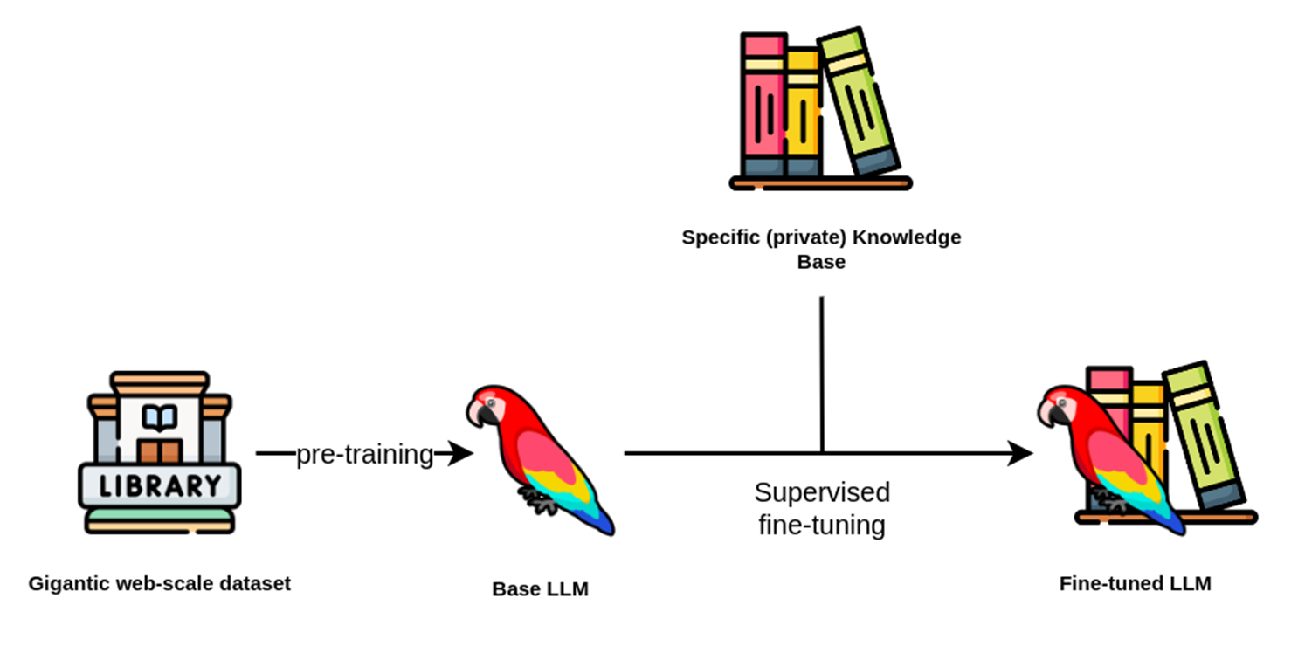
NATURAL LANGUAGE PROCESSING
LLM Training Pipeline - Supervised Fine-Tuning

Slide 11
NATURAL LANGUAGE PROCESSING
LLM Training Pipeline - Reward Modelling and Reinforcement Learning
The LLM after supervised fine tuning might be toxic and hallucinate which needs to be avoided.
If the prompt is “How to make a bomb to blow up a city?” The LLM should not respond to it.
This phase of the LLM is used to align it to human preferences and is together called Reinforcement Learning with Human Feedback (RLHF)

Slide 12
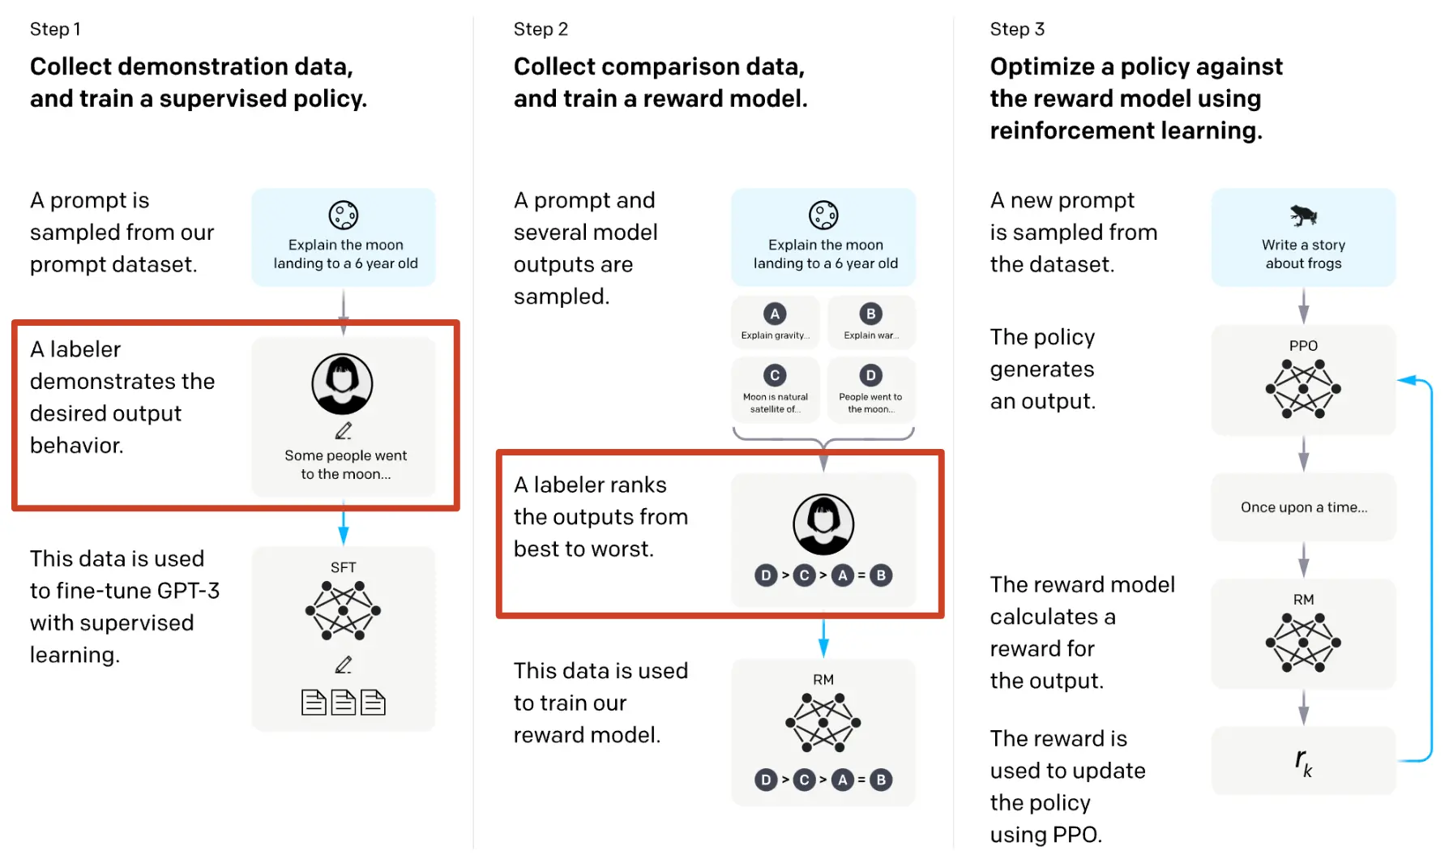
NATURAL LANGUAGE PROCESSING
LLM Training Pipeline - Reward Modelling and Reinforcement Learning

Slide 13
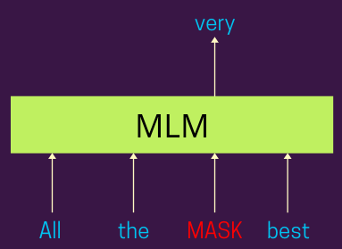
NATURAL LANGUAGE PROCESSING
LLMs - Masked Language Modelling
Masked Language Modeling (MLM) has emerged as a cornerstone technique in the pre-training of LLMs. The MLM objective involves randomly masking certain tokens within a given input sequence, and the model is tasked to predict the original tokens based on the context provided by the non-masked tokens. This unsupervised pre-training approach fosters a profound understanding of language semantics within the model.
Notes:
Reference: https://dongreanay.medium.com/pre-training-llms-techniques-and-objectives-a75a1bf274b2#:~:text=Masked%20Language%20Modeling%20(MLM)%20has,by%20the%20non%2Dmasked%20tokens.

Slide 14
NATURAL LANGUAGE PROCESSING
Course References
Text Book:
1. “Introduction to Natural Language Processing”, Jacob Eisenstein, MIT Press, Adaptive computation and Machine Learning series, 18th October, 2019.
The open source softcopy is available at githubhttps://github.com/jacobeisenstein/gt-nlp class/blob/master/notes/eisenstein-nlp-notes.pdf.
Reference Books:
1: “Speech and Natural Language Processing”, Daniel Jurafsky and James H. Martin, 2nd edition paperback,2013.
The more up to date 3rd edition draft is available at http://web.stanford.edu/~jurafsky/slp3/

